Slide 1
T-508 (ESTB) Tests of Shaslyk Calorimeter Modules from HERA-B
Dr. Edward Brash
Christopher Newport University and Jefferson Lab

Slide 2
Purpose
The aim of these tests is to measure the position and energy resolution of a number of “Shaslyk” lead-scintillator sandwich type calorimeters which we have on loan from DESY. These modules were used in the HERA-B calorimeter.
We are evaluating these modules to ascertain if they are adequate for use in an upcoming experiment at Jefferson Lab.

Slide 3
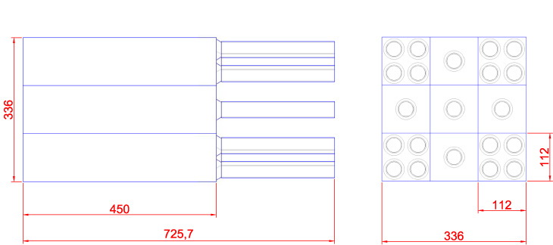
Arrangement of Calorimeter Modules

Slide 4
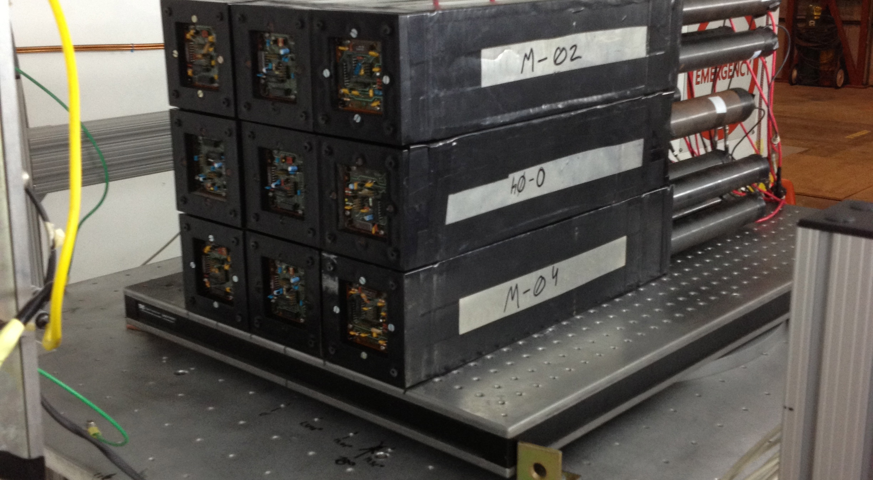
Current Status

Slide 5
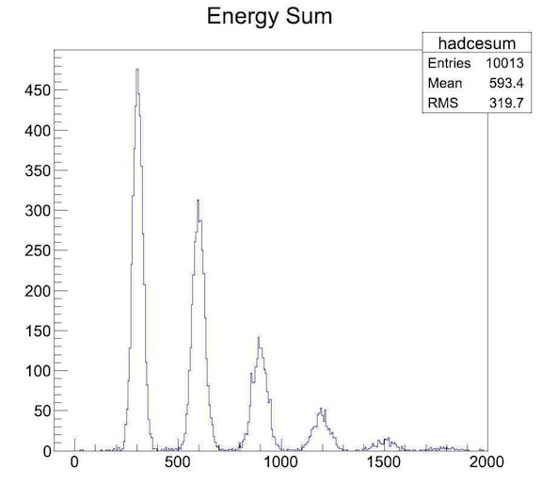
3 GeV Beam

Slide 6
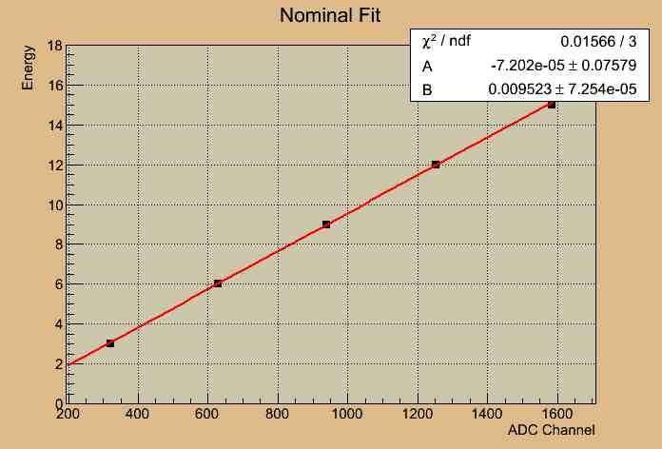
3 GeV Beam

Slide 7
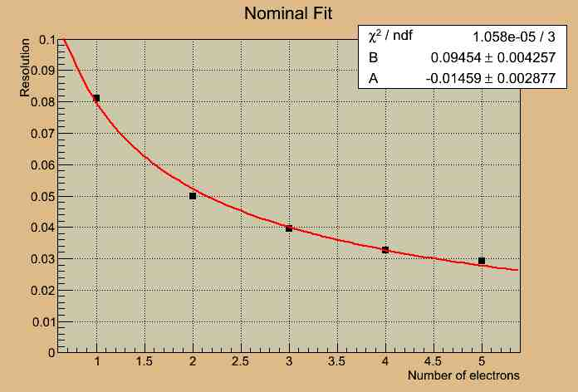
3 GeV Beam

Slide 8
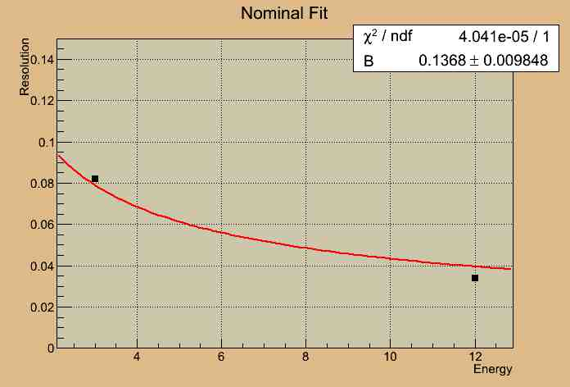
3 GeV Beam

